Slide 1
Section 8: Model-View-Controller
Slides adapted from Alex Mariakakis
with material from Krysta Yousoufian, Kellen Donohue, and James Fogarty

Slide 2
Homework tips
You must include the @SuppressWarnings("nullness") tags so that your code will build during grading
Run ant validate on attu before submitting
HW7 requires you to modify your code from HW5 and HW6
Make sure to address any issues you had that caused you to fail HW5 or HW6 staff tests

Slide 3
MVC
The classic design pattern
Used for data-driven user applications
Such apps juggle several tasks:
Loading and storing the data – getting it in/out of storage on request
Constructing the user interface – what the user sees
Interpreting user actions – deciding whether to modify the UI or data
These tasks are largely independent of each other
Model, view, and controller each get one task

Slide 4
Model
talks to data source to retrieve and store data
Which database table is the requested data stored in?
What SQL query will get me the data
I need?

Slide 5
View
asks model for data and presents it in a user-friendly format
Would this text look better blue or red? In the bottom corner
or front and center?
Should these items go in a dropdown list or radio buttons?

Slide 6
Controller
listens for the user to change data or state in the UI, notifying the model or view accordingly
The user just clicked the “hide details” button. I better tell the view.
The user just changed the event details. I better let the model know to update the data.

Slide 7
Benefits of MVC
Organization of code
Maintainable, easy to find what you need
Ease of development
Build and test components independently
Flexibility
Swap out views for different presentations of the same data (ex: calendar daily, weekly, or monthly view)
Swap out models to change data storage without affecting user

Slide 8
MVC Flow in Theory
View
Model
Controller

Slide 9
MVC Flow
In theory…
Pattern of behavior in response to inputs (controller) are independent of visual geometry (view)
Controller contacts view to interpret what input events should mean in the context of the view
In practice…
View and controller are so intertwined that they almost always occur in matched pairs (ex: command line interface)
Many architectures combine the two

Slide 10
MVC Flow in Practice
View
Model
Controller

Slide 11
Homeworks
HW8 – fine to keep view and controller together
HW9 – separate the view and controller

Slide 12
Push vs. Pull
View
Model
Controller

Slide 13
Push vs. Pull Architecture
Push architecture
As soon as the model changes, it notifies all of the views
Pull architecture
When a view needs to be updated, it asks the model for new data

Slide 14
Push vs. Pull Architecture

Slide 15
Push vs. Pull Architecture
Advantages for push
Guaranteed to have latest data in case something goes wrong later on
Advantages for pull
Avoid unnecessary updates, not nearly as intensive on the view

Slide 16
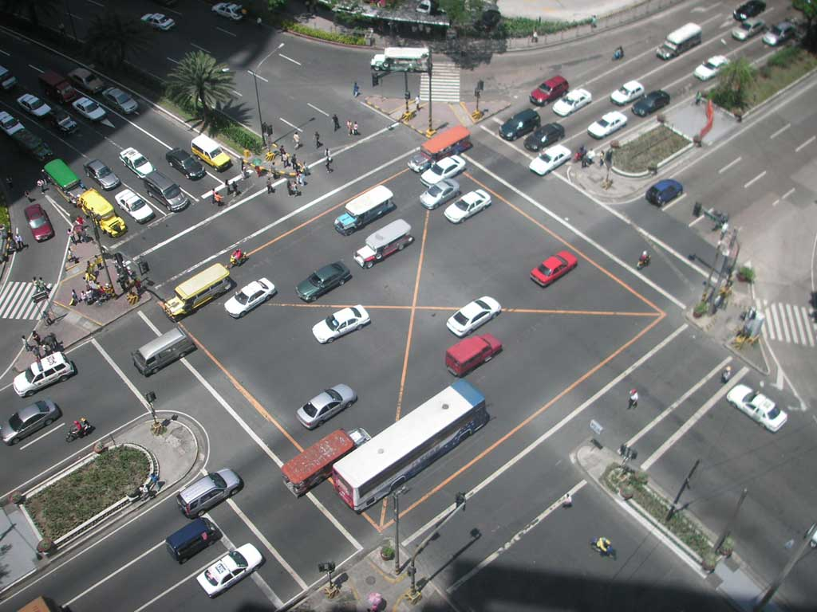
MVC Example – Traffic Signal

Slide 17
Traffic Signal – MVC
Component | Model | View | Controller
Detect cars waiting to enter intersection
Traffic lights to direct car traffic
Regulate valid traffic movements
Manual override for particular lights
Detect pedestrians waiting to cross
Pedestrian signals to direct pedestrians
External timer which triggers changes at set interval
X
X
X
X
X
X
X

Slide 18
Traffic Signal
Model
Stores current state of traffic flow
Knows current direction of traffic
Capable of skipping a light cycle
Stores whether there are cars and/or pedestrians waiting
View
Conveys information to cars and pedestrians in a specific direction
Controller
Aware of model’s current direction
Triggers methods to notify model that state should change

Slide 19
Traffic Signal Code
Model
TrafficModel – keeps track of which lights should be on and off
View
CarLight – shows relevant state of TrafficModel to cars
PedestrianLight – shows relevant state of TrafficModel to pedestrians
Controller
PedestrianButton – notifies TrafficModel that there is a pedestrian waiting
CarDetector – notifies TrafficModel that there is a car waiting
LightSwitch – enables or disables the light
Timer – regulates time in some way, possibly to skip cycles

Slide 20
HW8 Overview
Apply your generic graph & Dijkstra’s to campus map data
Given a list of buildings and walking paths
Produce routes from one building to another on the walking paths

Slide 21
HW8 Data Format
List of buildings (abbreviation, name, loc in pixels)
BAG Bagley Hall (East Entrance) 1914.5103,1708.8816
BGR By George 1671.5499,1258.4333
List of paths (endpoint 1, endpoint 2, dist in feet)
1903.7201,1952.4322
1906.1864,1939.0633: 26.583482327919597
1897.9472,1960.0194: 20.597253035175832
1915.7143,1956.5: 26.68364745009741
2337.0143,806.8278
2346.3446,817.55768: 29.685363221542797
2321.6193,788.16714: 49.5110360968527
2316.4876,813.59229: 44.65826043418031
(0,0) is in the upper left

Slide 22
MVC in HW8
Model stores graph, performs Dijkstra’s
View shows results to users in text format
Controller takes user commands and uses view to show results
View and Controller will change in HW9, but Model will stay the same

